Slide 1

DECISION MODELLING FOR BUSINESS ANALYTICS
Prepared By : DHAVALA SHARMA

Slide 2

MODEL DESCRIPTION
ROVOTEL is a five-star hotel situated in the heart of the Melbourne. ROVOTEL has their own hotel booking management and reservation system. Due to the upcoming holiday season, ROVOTELl’s sales manager wants us to investigate and explore decisions and risks relating to hotel booking management (and reservation limits).
Sales manager at the hotel wants to analyse the decision options available to him after changing the inputs for cost and revenue. There are several factors that effects the cost and profit margins such as fixed room cost for every room, basic utility cost for every room, advertising expenses, booking cancelation cost, overbooking cost and many more.
In our model we seek to maximise first quarter profits of the hotel at two different hotel toom prices. Profit= (Price – Variable Cost) X Demand – Fixed Cost

Slide 3

KEY ASSUMPTIONS
In our dataset, we have set the price of the Standard Rooms as $599 per day, whereas the price of Deluxe Rooms has been set to $699 per day.
Total number of rooms available are 500 rooms.
When the price was set as $599, the average demand is 495 rooms.
When the price was set as $699, the average demand is 400 rooms.
In the case of Overbooking, we provide our customers with almost same price and condition in nearby hotels.
Overbooking in our dataset depicts that our hotel has tied up in a partnership business with other hotels, so the customer indirectly pays to our respective firm itself.
Overbooking price is set as $15,000.
Cancellation price is set as $40,000.
The fixed inputs:
Room costs = $120
Advertising Expenses = $80
Basic Utility Cost = $20

Slide 4
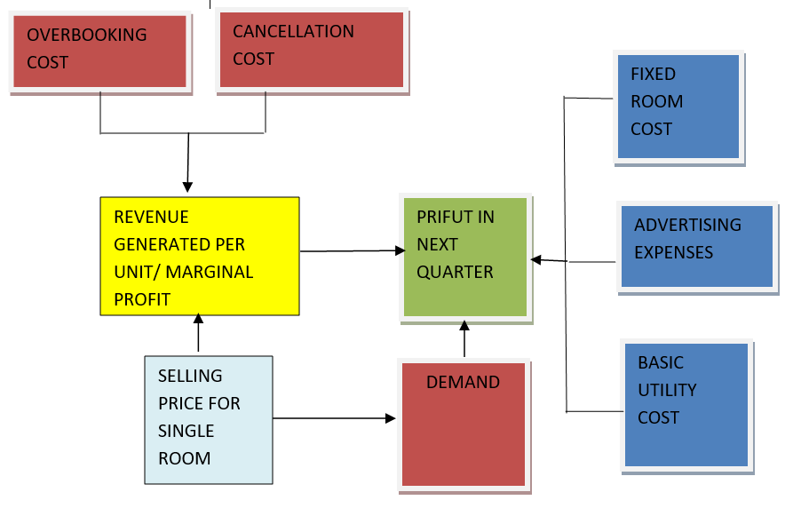
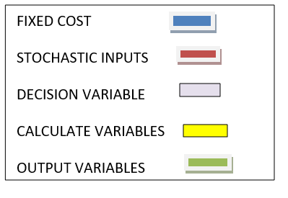
CONCEPTUAL MODEL

Slide 5
SPREADSHEET BASED DECISION MODELS
INPUTS IN OUR DECISION MODEL ARE :-
FIXED INPUTS
FIXED ROOM COST
ADVERTISING EXPENSES
BASIC UTILITY COST
STOCHASTIC INPUT
OVERBOOKING COST
CANCELLATION COST
NUMBER OF BOOKINGS (DEMAND)
DECISION VARIABLES
SELLING PRICE
CALCULATED VARIABLES
MARGINAL PROFIT/ REVENUE GENERATED PER UNIT
OUTPUT VARIABLES
PROFIT IN NEXT QUARTER

Slide 6
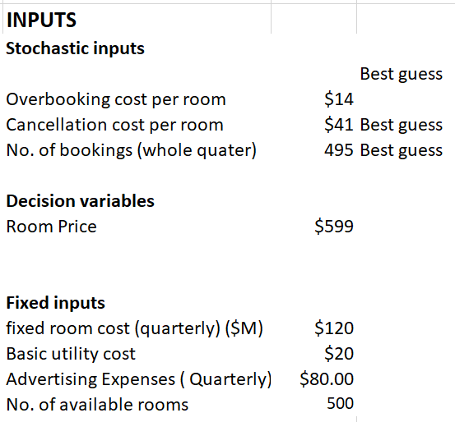
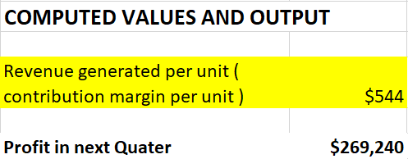
DECISION MODEL (PRICE = $599)

Slide 7
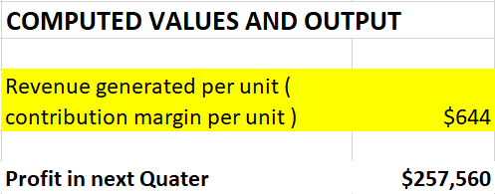
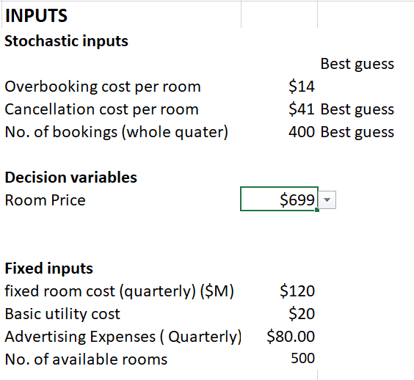
Decision Model (Price = $699)

Slide 8
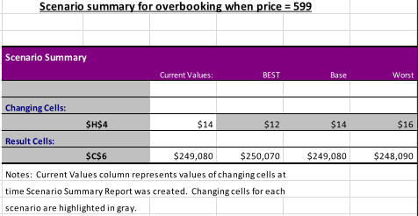
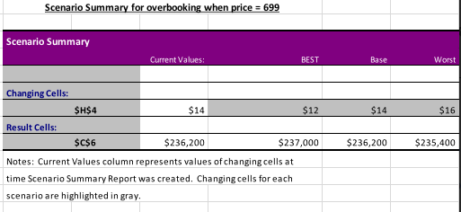
SCENARIO ANALYSIS
In this case, when we talk about the Standard Rooms (Price = $599), But if we take the base price of the Standard rooms as $14, we get a revenue of $249,080, and in the worst scenario if the price is set up to $16, the business will be experiencing a significant loss and the revenue experienced will be $248,090, so the best price we will get is $12 under which we will experience a revenue of $250,070.
In this case, when we talk about the Standard Rooms (Price = $699), But if we take the base price of the Deluxe rooms as $14, we get a revenue of $236,200, and in the worst scenario if the price is set up to $16, the business will be experiencing a significant loss and the revenue experienced will be $235,400, so the best price we will get is $12 under which we will experience a revenue of $237,000.

Slide 9
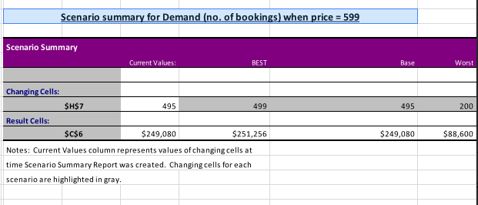
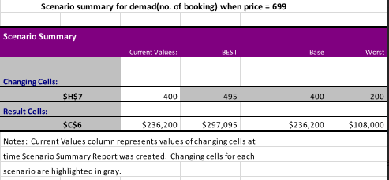
In this case, when we talk about the Standard Rooms (Price = $599), But if we take the base price of the Standard rooms as $495, we get a revenue of $249,080, and in the worst scenario if the price is set down to $200, the business will be experiencing a significant loss and the revenue experienced will be $88,000, so the best price we will get is $499 under which we will experience a revenue of $251,256.
In this case, when we talk about the Standard Rooms (Price = $699), But if we take the base price of the Deluxe rooms as $400, we get a revenue of $236,200, and in the worst scenario if the price is set down to $200, the business will be experiencing a significant loss and the revenue experienced will be $108,000, so the best price we will get is $495 under which we will experience a revenue of $297,095.

Slide 10
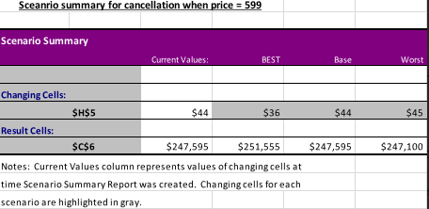
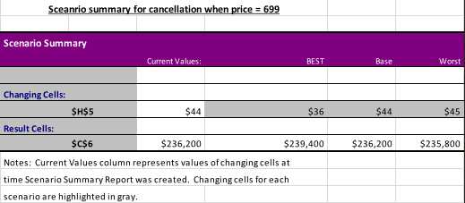
In this case, when we talk about the Standard Rooms (Price = $599), But if we take the base price of the Standard rooms as $44, we get a revenue of $247,595, and in the worst scenario if the price is set up to $45, the business will be experiencing a significant loss and the revenue experienced will be $247,100, so the best price we will get is $36 under which we will experience a revenue of $251,555.
In this case, when we talk about the Standard Rooms (Price = $699), But if we take the base price of the Deluxe rooms as $44, we get a revenue of $236,200, and in the worst scenario if the price is set up to $45, the business will be experiencing a significant loss and the revenue experienced will be $235,800, so the best price we will get is $36 under which we will experience a revenue of $239,400.

Slide 11

STOCHASTIC MODEL
Stochastic Modelling is majorly helpful in making Investment decisions, This type of modelling is a process in which we take a sample randomly and then predict the chances of getting different result under different circumstances.
We have two stochastic models to justify distribution under which one is forecasted by price taken as follows:
$599 as the Standard rooms
$699 as the deluxe rooms

Slide 12

STOCHASTIC MODEL
Overbooking cost per booking
Cancellation cost per booking
No. of bookings

Slide 13

STOCHASTIC INPUTS DISTRIBUTION
Uniform Distribution
We have performed Uniform distribution in overbooking cost per room as well as Cancellation cost per room as we know the upper and lower limit of the data which helps us in performing such kind of distribution analysis, if we had to perform any other sort of distribution analysis we were not provided with enough range of dataset / Information.
Normal Distribution
Normal distribution analysis is performed when you know the upper limit, lower limit as well as the standard deviation of the dataset, as we performed this distribution analysis our data got distributed normally and we were provided with a symmetrical curve shaped graph.

Slide 14
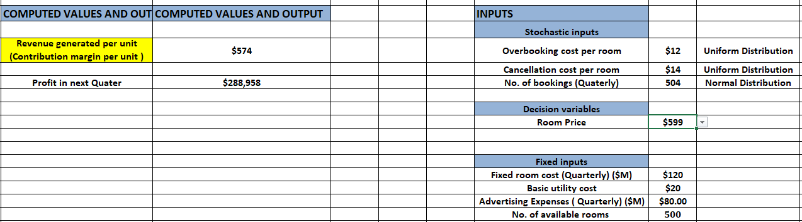
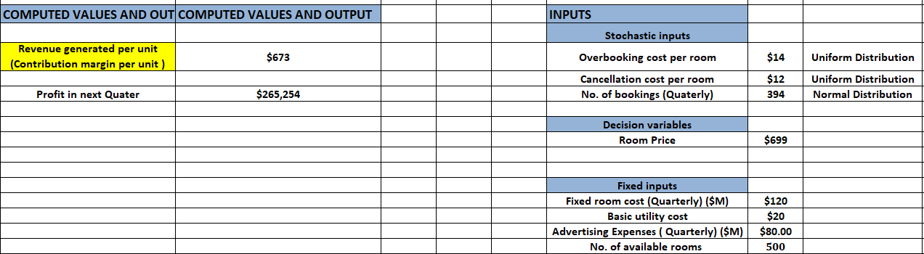
DISTRIBUTION OF STOCHASTIC INPUTS

Slide 15
SIMULATED DISTRIBUTIONS OF OUTPUT
The graph below displays the convergence of mean contribution margin when price is $599. we can see that the values are changing and there are no sudden peaks, there fore I can say that the convergence is ensured in out data.
The graph below shows the convergence of mean contribution margin when price is $699. we can see that the values are changing and there are no sudden peaks, therefore I can say convergence is ensured in our data.

Slide 16
SIMULATED DISTRIBUTIONS OF OUTPUT
The graph below displays the convergence of mean first quarter when price is $599. We can see that the values are changing and there are no sudden peaks, there fore I can say that the convergence is ensured in out data.
The graph below shows the convergence of mean first quarter when price is $699. we can see that the values are changing and there are no sudden peaks, therefore I can say convergence is ensured in our data.

Slide 17
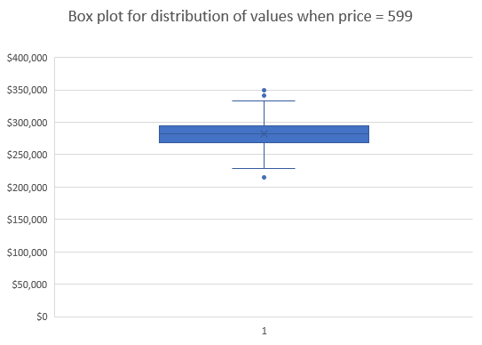
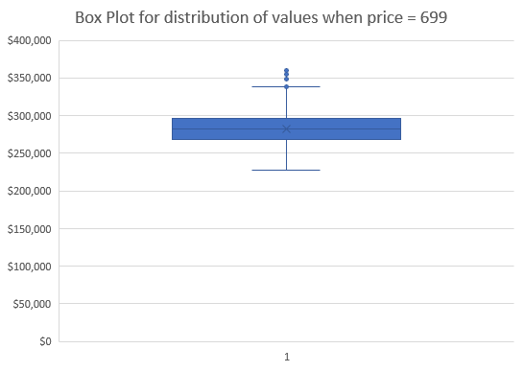
Simulated Model - Data Distribution
The below box plot gives us an visualisation of distribution of values in our data when price is set at $599 The box plot shows that the data is normally distributed.
The below box plot gives us an visualisation of distribution of values in our data when price is set at $699.
The box plot below shows that values are normally distributed.

Slide 18
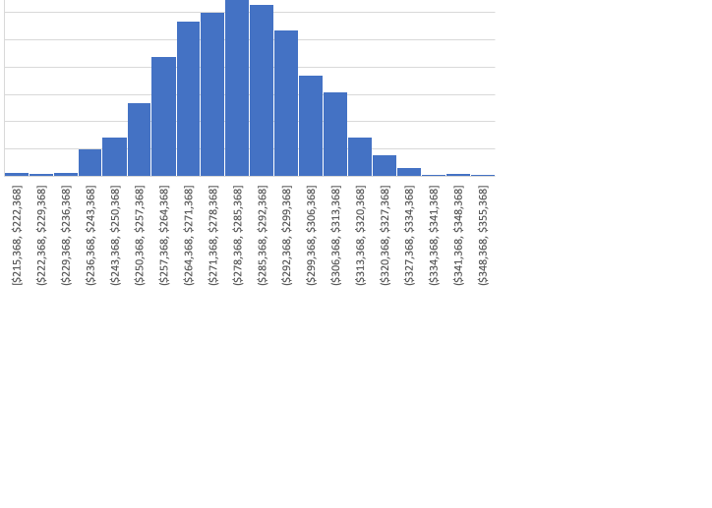
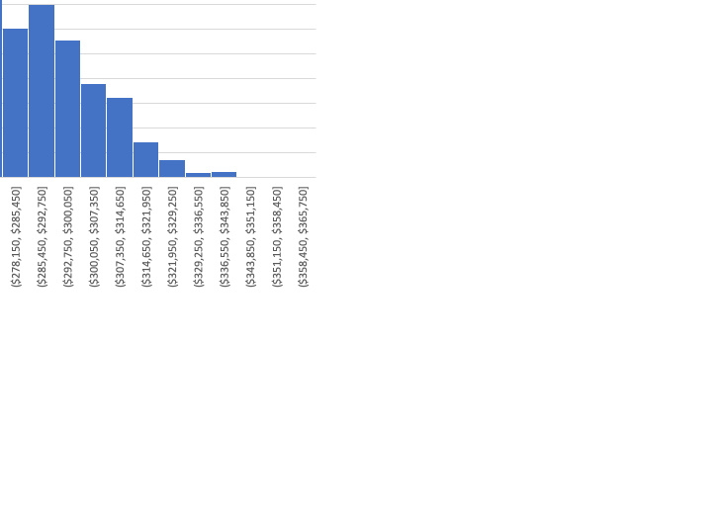
Simulated Model - Data Distribution
The below histogram gives us a visualisation of distribution of values in our data when price is set at $599. Our histogram is bell shaped shows that the data is normally distributed.
The below histogram gives us a visualisation of distribution of values in our data when price is set at $699.
Our histogram is bell shaped shows that the data is normally distributed.

Slide 19
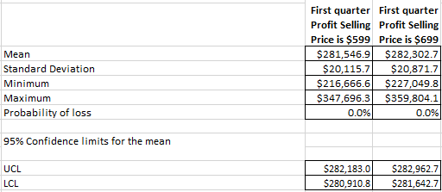
Descriptive statistics of Simulated Output
From the table we could figure out the average profit is slightly higher when price is set at $699.
There is a minimum profit of $216666, when Price=$599
There is a minimum profit of $227049, when Price=$699
There is a maximum profit of $347696, when price = $599
There is a maximum profit of $359804, when price=$ 699

Slide 20
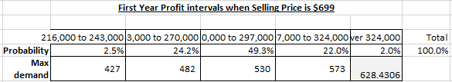
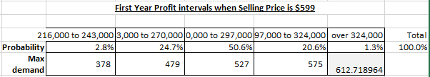
RISK ANALYSIS
We have applied probability distribution on stochastic inputs. Thousand data stimulation trials are generated with summary outputs in order to further evaluate the risks associated with business.

Slide 21
RISK ANALYSIS INTERPRETATION
There is 2.5 % probability of making minimum profts when price is set at $699. There is a 2.8% chance of making minimum profits when price is set $599. the chances of making minimum profits increases by 0.3% when price is set at $599.
There is a 2% chance of making maximum profit when price is $699, which is over $324000. the chances of making maximum profit decreases by 0.7%, if the prices are set at $599.
Main driver of profit and loss is high variability of demand. So the sales manager need to vigilant in monitoring sales.
The chances of making higher profits is higher in case when price is set at $699.
The probability of making less profit is higher when price is $599.
If the sales manager if looking increases chances of higher profits, he should set the price at $699.

